Slide 1
Toward a Post 2015 DRR Framework
Jean Luc Poncelet, MD, MPH

Slide 2
Main achievements of HFA
Build on Yokohama declaration
Disaster Risk can be reduced to a large extend
Concrete results like Safe Hospitals Campaign
At present 10% of the 17,600 hospitals have been assessed
out of 462 hospitals 17 % are Cat C
57% have been intervened
A regional plan approved by MoH
A safety index developed an used
for other facilities (education…)

Slide 3
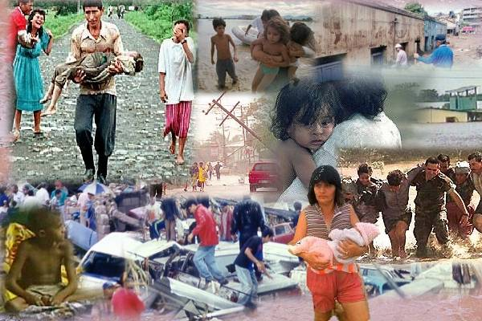
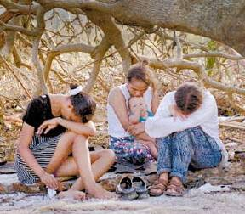
Challenge 1: address the real issue
Disaster is health and social impact

Slide 4
Challenges 2
Define reachable targets
It took centuries to build the vulnerability of our society ….
Gain a real Political support for issues that require more then a 4 year mandate to make a difference
Cut it smaller pieces
The stove pipe approach of our society:
Health of the community is seen as health sector responsibility however there is no safe hospitals without electricity, water, access/road, paid personal, etc…
Identify a common across-the-sector target (multi-setorial)

Slide 5
Criteria for Post 2015
Go to the roots of disaster impact:
Select topics that link (more) concretely risk reduction to protecting community physical, mental and social well-being.
Go to the real challenge of risk reduction: its “multi-sectorial” nature. Health is the most dependent of all issue in our society. A health issue in which all sector can contribute is the best indicator of our post 2015 success.

Slide 6
Millennium development goal post 2015
MDG post 2015 should ensure that all new investment and activities contribute at increasing resilience.

Slide 7
www.paho.org/disasters Knowledge center www.healthanddisasters.info
Thank You

